Slide 1
ESD Control In
Electronic
Assembly
Tom Watkins
President
Transforming Technologies

Slide 2
Outline
Generation of Static Charge
Effects of Static Charge
  Physical damage
  Contamination
  Automation issues
Elements of ESD Control
Ionization
Ionizer Maintenance
Summary

Slide 3

Generation of
Static Charge

Slide 4
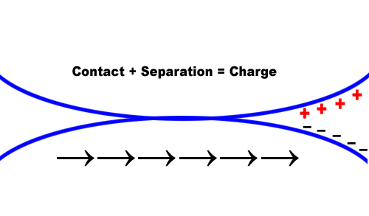
Static Charge from Contact and
Separation of Dissimilar Objects
One Object is Positively Charged and the Other is Negatively Charged
Contact and Separation is the Recipe

Slide 5
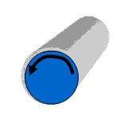
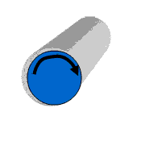
Moving Over Rollers or Sliding Through
Tubes is contact and separation
Contact and separation

Slide 6
Wet Cleaning – a Major Process

Slide 7
Manual or Automated Handling
++++++
++++++

Slide 8
Sources of Tribocharging
Contact and Separation of Dissimilar Materials
Product handling
  Tweezers
  Robots
  Rollers
  Suction cups
  Parts on reel
Wet Processes
Wipe Down
Personnel
  In chairs
  On floor
  Against walls
Product Storage
  In/Out of carriers
  Moving across work surfaces
Plastics
  Packing material
  Plastic Sheet protectors

Slide 9
Triboelectric Charging
Charge generation:
The Materials Used Encourage Transfer:
Positive
+
Negative
-
Latex
Human Hands
Quartz
Nylon
Aluminum
Chrome
Steel
Polyurethane
Polyethylene
Polypropylene
PVC (Vinyl)
Polycarbonate
Mylar
Teflon
Triboelectric Charging

Slide 10
Problems Related to Static Charge
Electrostatics and
Physical Damage

Slide 11
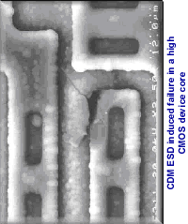
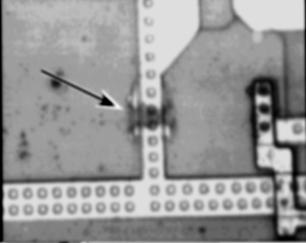
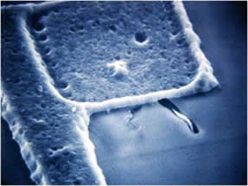
Fields from Static Charge Cause
Micro Electronics to Spark and Die
Notes:
Here are some examples of electrostatic damage to silicon. We do not have any pictures of damage to silicon on flat panels and we would be very pleased if you could help us get some.

Slide 12
Damage Can Happen Several Ways
Charged operator
contacts part (called HBM)
Charged part contacts
ground (Called CDM)
`
Charged object (tool)
contacts part (Called MM)
`

Slide 13
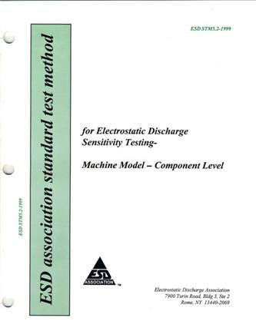
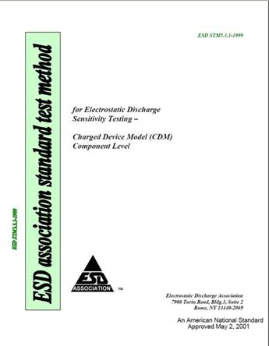
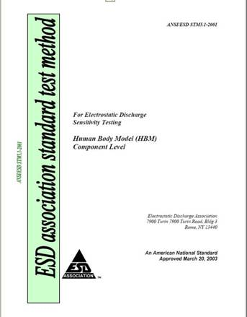
Understanding the Three Models

Slide 14
Electrostatics
and Contamination

Slide 15
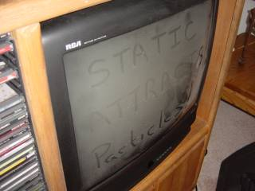
Static Charge is a Contamination Issue
Charged surfaces attract contamination strongly
Notes:
Talk about electrostatic attraction (ESA)
Issues of contamination are severe for FPD manufacturing. One stuck pixel will stand out to anyone who looks at a display and this is exactly what contamination does to the display. Contamination control is the most important consequence of static charge in array and CF.

Slide 16
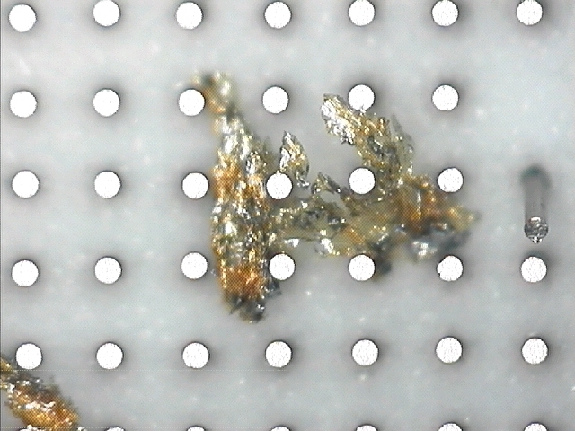
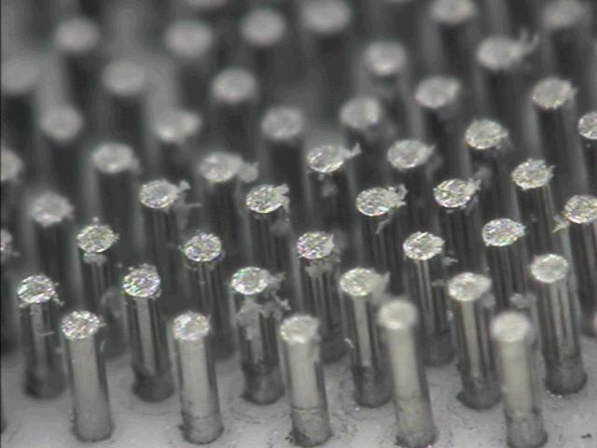
Contaminated Contacts Makes Testing Unreliable

Slide 17
Electrostatics
and EMI

Slide 18

ESD Radiates High Frequency EMI
Automated Tool
Microprocessor
Unexpected stop
Occasional Tool Issues more more difficult to diagnose than continuous issues

Slide 19
Elements of an
ESD Control Program

Slide 20
What Must be Neutral?
The Product must be kept Neutral
The environment must Also be kept neutral!
What are the Major Steps to Achieve This?
Ground Conductors whenever possible
Avoid Insulators whenever possible

Slide 21
An ESD Control Program
Eliminate Static Charge from All Surfaces Near Product
Step 1 Ground conductors – this includes workers:
  wrist straps,
  ESD shoes, ESD Chairs
  ESD garments
Step 2 Eliminate insulators wherever possible: plastics are the worst offender
Step 3 – what about remaining insulators and ungrounded conductors?

Slide 22
Ionizers Neutralize Static Charge on Insulators & Isolated Conductors
-
-
+
-
-
+
-
+
-
+
+
Air Ions
-
+
-
+
-
+
+
-
+
-
-
-
+
-
-
+
+
-
-
+
+
+
+
+
+
+
+
- - - - - - - - - - - -
Charged
Insulator
Air Ions travel to the charged object , contact it and neutralize it.
Nothing else neutralizes insulators or isolated conductors

Slide 23
Static-Safe Workstation
Grounded Shelves
ESDC Wrist
Strap
ESDC Chairs
Balanced
& Carts
Ionizer
ESDC Containers
Tested AC
& Ground
ESDC Worksurface
Circuit
ESD Work Station
Common
Point
Ground (CPG)
ESD Controlled Floor

Slide 24
Ionization

Slide 25
A Basic Corona Ionizer
5-20 kV
Intense Electric Field
Positive HV makes Positive Ions
Negative HV makes Negative Ions
Notes:
The process requires rather high voltage and it is necessary to make both positive and negative ions

Slide 26
Alpha Technology
Sealed source
Perfectly balanced for the most sensitive devices
No electrical power required
No maintenance for 1 year
Inherently safe
Ion cloud created by alphas
~1”
Place target close
(just beyond 1”)
Or use a blower to deliver ions

Slide 27
Most Ionizers Use a Fan to Blow Ions to the Target Object(s)
One parameter of an ionizer is the amount of air flow

Slide 28
DC vs AC Technology
DC
AC
-HV
+HV
HV
Separating points minimizes recombination
Used in ultra clean applications
Requires periodic adjustment of balance
Requires frequent cleaning
More expensive
Requires slightly more air flow
Used in most assembly applications
Requires no balance adjustment
Cleaning required only infrequently
Simplicity means reliability!

Slide 29
Types of AC Ionizers From Transforming Technologies
Conventional AC
Piezoelectric AC
HV
68 KHz Oscillator
Input
Piezoelectric
“Transformer”

Slide 30
AC Technology
Inherently balanced requiring NO adjustment
Infrequent cleaning requirements compared to DC technology
Transforming Technology’s ionizers have quick release grids or built in cleaner to minimize the time to clean an ionizer

Slide 31
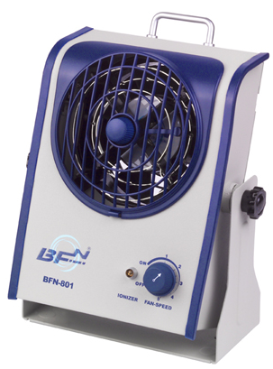
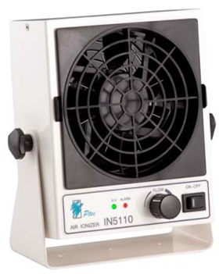
Comparison of Technologies
Conventional AC
Transformer weight requires stiffer mounting bracket
Offers faster discharge
Use to 12” from product
Built in cleaning tool
Piezoeletric AC
Very light weight
High frequency virtually eliminates any swing
Use to 6” from product
Removable grilles for easy cleaning
Both offer exceptionally low maintenance, high reliability and automatic voltage balance

Slide 32
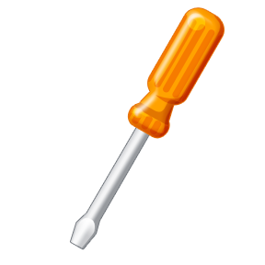
Maintaining The Ionizers
Conventional Ionizers
IN-Series Piezo Ionizers
BFN-Series AC Ionizers
Unscrew grille to clean emitter points
Grill pops off with no tools for point cleaning
Ionizer is cleaned by turning a knob

Slide 33

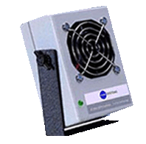
These Bench Top Blowers Work Well in
Workstations
Inspection stations and microscopes
Automated process steps
Tester stations and Probe stations

Slide 34


Overhead Blowers Have Many Advantages
  Covers Volume or large Area
  Eliminates Dry Eyes – operators prefer overheads!
  Not blocked by Obstacles on the Work Surface
BFN AC Ionizer includes cleaning knob
and illumination lights
Available as 2 fan and 3 fan units
IN Series Piezo Ionizer includes Available as
A 2 fan unit.
Snap-off grills for easy cleaning
Exceptionally light for easy mounting

Slide 35
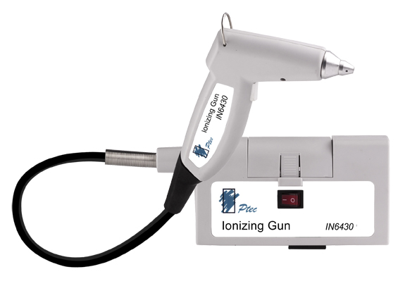
Blow Off Gun to Clean and
Discharge a Surface
Blow away stubborn contaminants by discharging them first
Ergonomic shapoe for easy use
Extremely fast discharge
Integral power and air cable
Extremely loing time between cleanings
Inherently balanced/. No adjustment required

Slide 36
Ionization in Manual Assembly
Overhead
Ionizing Blower
Wide Area Coverage
Fast Discharge Time
Does not blow in operator’s eyes

Slide 37
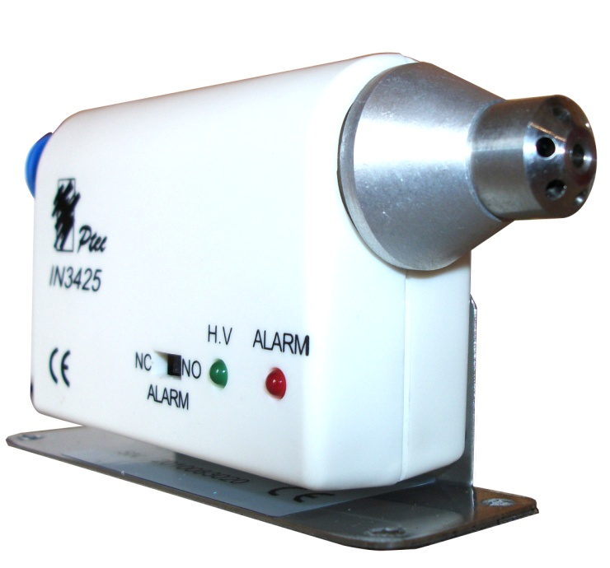
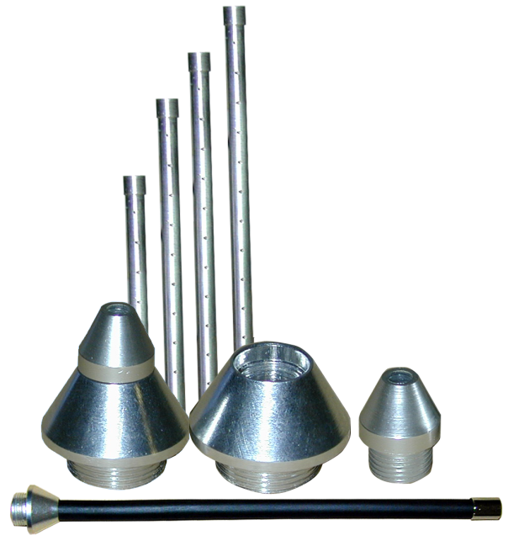
Air Nozzles
Gas Useful in Confined Spaces
Distance to Product: 5-50 cm
Discharge time: 0.5-20 sec typical
Nozzles can use interchangeable tips such as manifold, or bendable to deliver then ionization to the exact location required

Slide 38
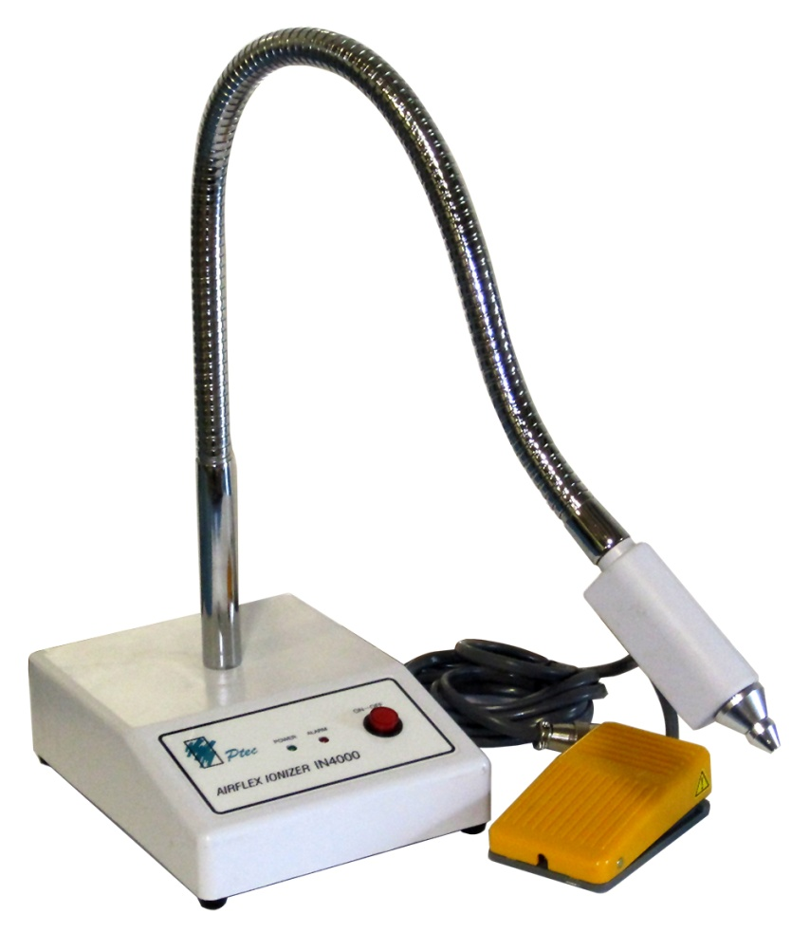
Unique Air Nozzle Ionizer for Directed Flow
Delivers the ions to a precise location
Ideal for manual assembly of small subassemblies
Foot switch for hands free operation
IN4000

Slide 39
Measuring Ionizer
Performance

Slide 40
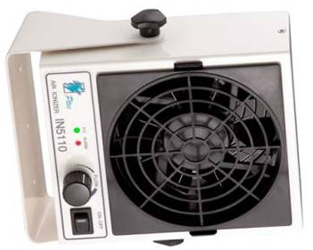
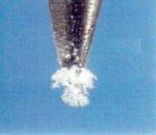
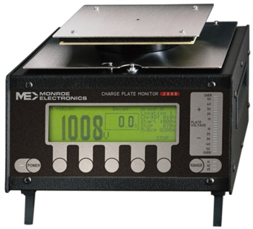
Ionizers Require Cleaning and Some Also Require Adjustment

Slide 41
Summary
Contact and Separation
It’s the Insulators
Choice of dissipative and conducting materials
Grounding
Ionizers
Personnel issues
  Apparel
  Grounding appliances
Tools
  Grounding
  Material choice
Education

Slide 42
Class Zero Control

Slide 43
Modern High Tech Products Are Extremely Sensitive To ESD

Slide 44
Conclusion
Static charge is a normal consequence of any component handling process.
The ESD hazard to ICs continues to increase as devices become more complex
Grounding and ionization are the static control methods employed to eliminate static charge
Ionizer maintenance is an important issue and must be considered when selecting an ionizer.
Customers now require control of static charge levels to 100 volts or less.

